Slide 1

Cybercrime in Italy, Context and Recommendations
Domenico Raguseo
Exprivia

Slide 2


Exprivia in numbers… and above numbers
Headquarter Exprivia SpA,
Via Adriano Olivetti n.11, 70056 Molfetta (BA).
Dott. Domenico Favuzzi,
Chairman & Chief Executive Officer
Industry
Aerospace
& Defence
Healthcare
Public
Sector
Telco
& Media
Energy
Finance
Since 1983 … 333 Milion Euro revenue in 2024
CyberSecurity
3660 employees
Support Processes
Digital Enablers
Clients and Branch Offices
in Italy, Mexico, Brasil, Spain,, Germany , China and India, UK
Clients also in Switzerland, Canada, Bulgaria, Romania, Hungary, Poland, Czech R., Russia, Slovak R., Serbia, Slovenja
Digital Infrastructure

Slide 3
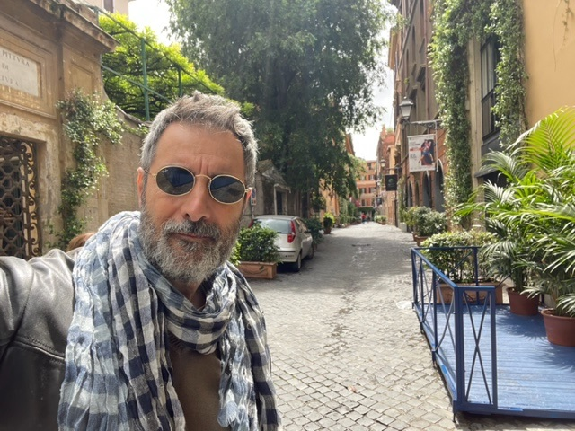
Who am I ( in a nutshell ) ?
Born in 63 in Molfetta, Bachelor at University of Bari in Computer Science, Business Client Insight at London Business School
Former Lieutenant in Artillery, Turin
Within 24868 certified in ITIL by Loyalist College of Applied Art and Technology ( Canada )
Married with IBM for 33 years, last role was CTO for Security for South Europe , CEE and Israel
Living in Rome with my wife , 1+1 kids and one cat
I Like Basketball, supporter of Bari soccer team
36 visited countries , Assigned in Austin and Raleigh, but Las Vegas is the city where I lived more outside of Italy .Volare and Hilton Executive cards
Speakers in conferences in 12 different countries, including US , UK and Israel
Since 2019 with Exprivia to create a CyberSecurity Unit ( SOCrates )
12K followers on twitter @domenicoraguseo and 14K on Linkedin
100+ articles : https://domenicoraguseo.tumblr.com/
Former IBM Master inventor ( the first italian ) with 10+ patents including US5784008, 102023000014760 in Exprivia

Slide 4


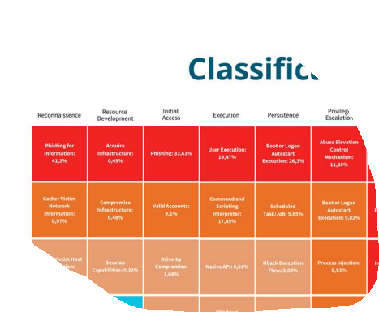
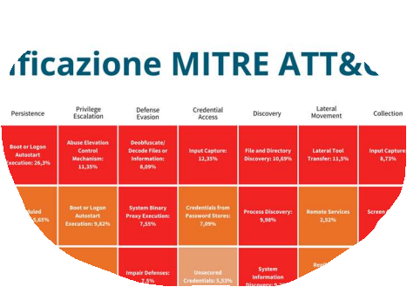



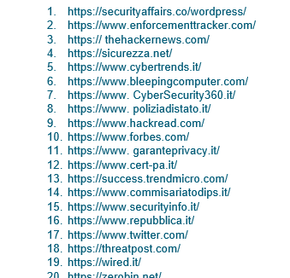
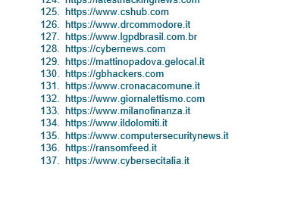
Threat Intelligence Analytics Peculiarities
MITRE ATT&CK®
FOCUS ON TERRITORY & CLIENTS
TRANSPARENT SOURCES OF INFO DIRECTLY IN THE REPORT

Slide 5
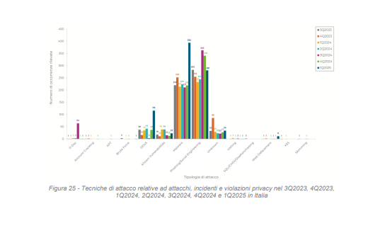
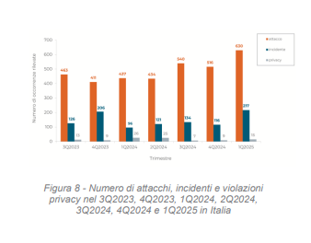
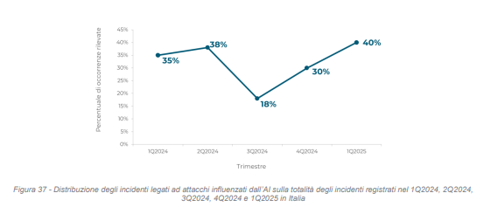
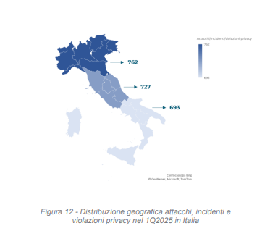
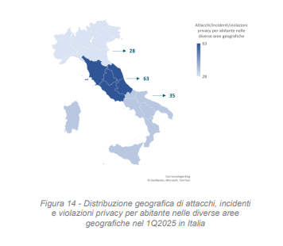
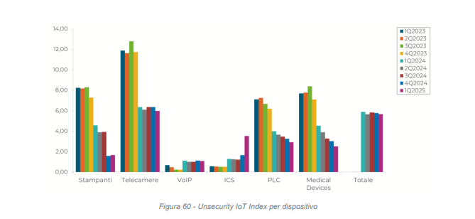
Cybercrime 1Q2025 - Italy

Slide 6
Reccomendations
Analysis of your threats and plan investments based on the reality
Investing in awareness is never a bad idea
First or later you will receieve an attack , the incident will depent on how fast you react
Do not forget that attackers are lazy and smart , attack what is simpler . For example IoT

Slide 7

Thanks
Follow @domenicoraguseo

